Slide 1
Excel Advanced
Session 3

Slide 2
Contents
Arrange Sheet Data
Filter and Sort options
Find and Replace options
Freezing
Advanced Formatting
Cell Formatting
Excel Tables and Range Name
Page Setup and Printing options
Advanced Functions
Errors
Lookup

Slide 3
Arrange Sheet Data
Filter and Sort options
Find and Replace options
Freezing

Slide 4

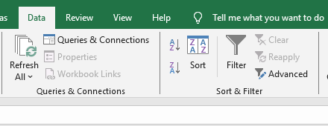
Filter & Sort options

Slide 5
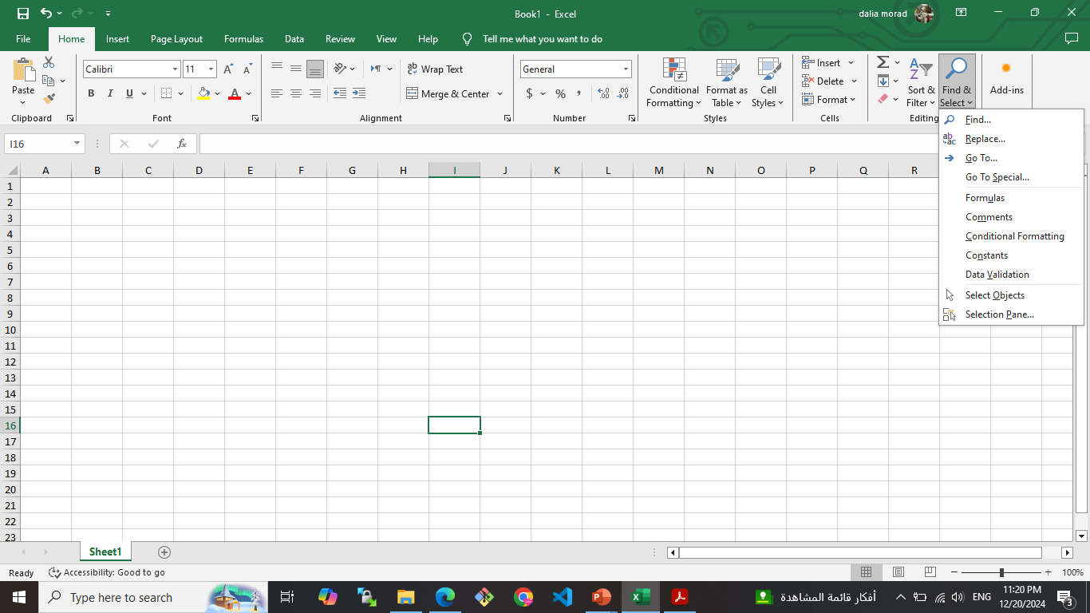
Find & Replace options

Slide 6
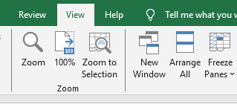
Freezing

Slide 7
Advanced Formatting
Cell Formatting
Excel Tables and Range Name
Page Setup and Printing options

Slide 8
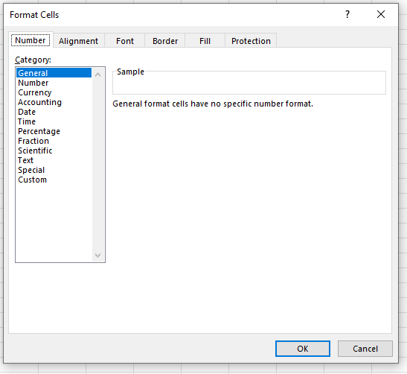
Cell Formatting

Slide 9
Range Name
Why Use Named Ranges
What Names Can be Used
Name a Range Ways
formulas
nameBox
R.C. ➔ define Name
Name Manager

Slide 10
Excel Table
Your column headings table, as you scroll down the table.
You can modify the colors used to format your table.
You can add rows at the bottom of the table and they remain a part of the table.
When you add a new row to the bottom of the table, any formulas in the row immediately above are copied, automatically, to the new row.
PivotTables and charts based on the table update automatically as you add information to the table

Slide 11
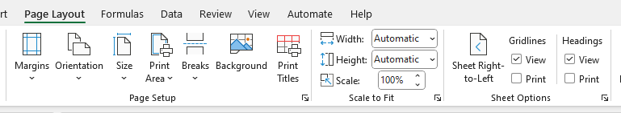
Page Setup & Printing options

Slide 12
Advanced Functions
Errors
Lookup

Slide 13
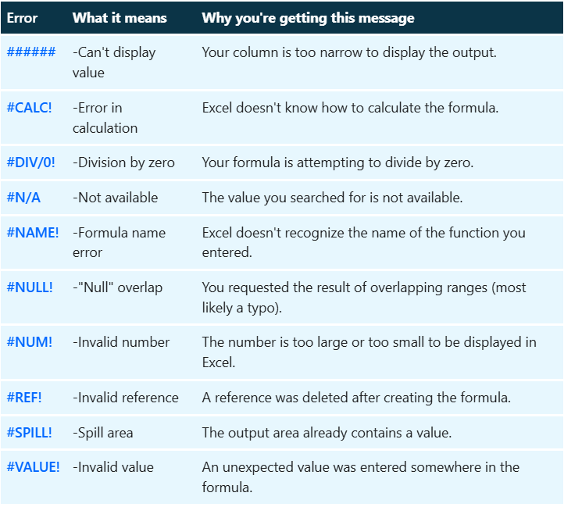
Errors

Slide 14
Lookup
VLOOKUP
HLOOKUP

Slide 15
Thank you
Brain Station
Eng. Dalia Morad
Excel Advanced S3

